Slide 1




MBC 638: Data Analysis & Decision Making
Anna Chernobai
Lecture 11:
Confidence interval for population mean (Chapter 8)

Slide 2
Today: Confidence interval
Confidence interval for population mean
Sample size selection

Slide 3
Confidence interval for μ
Main idea:
We have a sample and want to use sample mean to estimate population mean.
We know sample mean ( x ) from a particular random sample. In the C.L.T. topic, we saw that we can use sample mean as a point estimate to estimate the population mean (µ) but with an error.
In this topic, we will provide an interval estimate of the population mean. Specifically, we will estimate an interval such that with some high probability (e.g., 95%) we are certain that the true population mean µ lies within this interval. What we know about the distribution of x will help us!

Slide 4
Confidence interval for μ
Loosely speaking…
P(A < µ < B) = some high probability such as 0.95
Then, the 95% Confidence Interval for µ is [A, B]:
A
B
µ is somewhere here with 95% certainty

Slide 5
Confidence interval for μ
Some new terminology:
confidence level (e.g., 95%) is how certain you want to be
confidence level is defined in terms of
is the level of error you are willing to accept
Example:
Confidence level is 95%. 0.95 = 1- α. then α = 0.05.

Slide 6
Confidence interval for μ
Derivation:
Let’s start working “backwards,” using our knowledge about the
distribution of sample mean.
Zscore of observed sample mean
Z
A
B

Slide 7
Confidence interval for μ
(1 - α)% C.I. for µ is:
Assumption:
σ is known

Slide 8
Confidence interval for μ
A
B
Point Estimate of µ
Margin of Error
Margin of Error

Slide 9
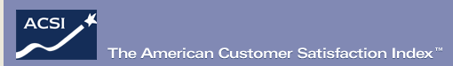

Confidence interval for μ
Example
The American Customer Satisfaction Index (ACSI) was established in 1994 by the University of Michigan to provide a new economic indicator tracking the quality of products and services from the perspective of the customer. The ACSI is the only measure of the quality of economic output nationwide. Research is showing the ACSI to be a leading economic indicator, and a predictor of financial performance at the firm level. http://www.theacsi.org/
In its 2008 survey, it reported that McDonald’s was last among 10 companies in the fast-food restaurant category. The survey was based on 1,000 customers’ responses. McDonald’s average score was 69 (out of 100 possible). For comparison, Starbucks had an average score of 77. Past data indicate that the standard deviation of the scores is 5.
Provide an interval estimate for the overall average satisfaction score for McDonald’s. Use 99% confidence level.

Slide 10
Confidence interval for μ
(1 - α)% C.I. for µ is:
Assumptions:
σ is unknown
❖ n is large (≥30)
Or: d.f. = n-1

Slide 11
Confidence interval for μ
Example
A random sampling of a company’s monthly operating expenses for a sample of n=36 months produced a mean of $5,474 and a standard deviation of $764.
a) With 98% confidence, the company’s true (=population) average monthly expenses fall in what range?
b) How many months of data are needed in order to reduce the margin of error of your estimated interval to half the size? One third the size?

Slide 12
Confidence interval for μ
Selecting appropriate sample size
If you want margin of error to be within some number B, then choose n according to the formula:
Round up your answer to the next digit.
Note: If σ is not given (but s is given) and n is large, use s instead.

Slide 13
Confidence interval for μ
(1 - α)% C.I. for µ is:
Assumptions:
σ is unknown
n is small (<30)
⬥ The sample is drawn from a bell-shaped population
Use t distribution. t distribution has one parameter:
d.f. = “degrees of freedom” = n – 1

Slide 14
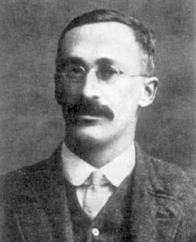
Confidence interval for μ
Student t distribution:
Where does the funny name come from?
It takes its name from William Sealy Gosset's 1908 paper in Biometrika under the pseudonym "Student". Gosset worked at the Guinness Brewery in Dublin, Ireland, and was interested in the problems of small samples, for example of the chemical properties of barley where sample sizes might be as low as 3. Gosset's employer forbade members of its staff from publishing scientific papers, so he had to hide his identity and wrote the paper under the pen name “Student”.
Source: Wikipedia
1876-1937

Slide 15
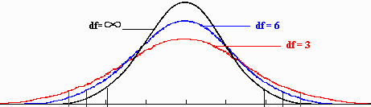
Confidence interval for μ
Student t distribution:
Is symmetric around 0, resembles standard Normal distribution
Is more “heavy-tailed” than the Normal distribution
Is commonly used for small samples. Approaches Normal distr. for large n
Has only 1 parameter: degrees of freedom = d.f. ( >0)
black = standard normal red, blue = t

Slide 16
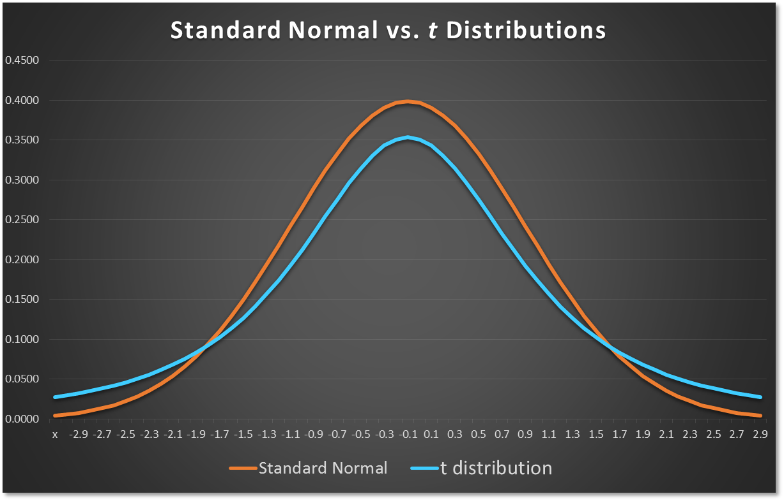
Confidence interval for μ
Student t distribution vs. Standard Normal:
Standard Normal distribution
t distribution

Slide 17
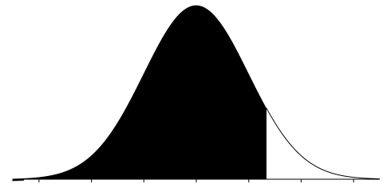
Confidence interval for μ
t distribution in Excel:
1. Finding probability:
= t.dist( tvalue , d.f. , TRUE)
2. Finding percentile: (what we need)
= t.inv(percentage , d.f.)
0 t
1 - α/2
0 t

Slide 18
Confidence interval for μ
Example
A random sampling of a company’s monthly operating expenses for a sample of n=16 months produced a mean of $5,474 and a standard deviation of $764.
With 98% confidence, the company’s true (=population) average monthly expenses fall in what range? Assume that the distribution of a firm’s monthly expenses is approximately bell-shaped.

Slide 19
Confidence interval for μ
Example
Periodically, Merrill Lynch customers are asked to evaluate Merrill Lynch financial consultants and services (2000 Merrill Lynch Client Satisfaction Survey) . Higher ratings on the client satisfaction survey indicate better service, with 7 the maximum service rating.
Independent samples of service ratings for 2 financial consultants—Ms. Daniels and Mr. Rossi are summarized here. Ms. Daniels has 10 years of experience, whereas Mr. Rossi has 1 year of experience.
At 95% confidence level (i.e., α=5%), provide an interval estimate for the overall average service rating for each consultant. Based on these intervals, can you determine whether the consultant with more experience provides better service?
Ms. Daniels : 56 reviews collected: mean=6.82 st.deviation=0.64
Mr. Rossi: 40 reviews collected: mean=6.25 st.deviation=0.75

Slide 20

Today: Confidence interval
Confidence interval for population mean
Sample size selection

Slide 21
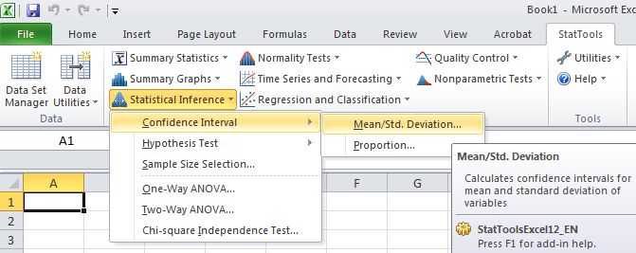
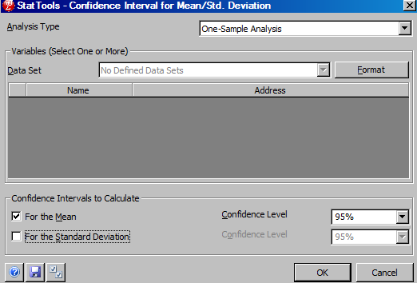
Confidence interval for μ in Excel
Excel: StatTools → Statistical Inference → Confidence Interval → Mean
For μ

Slide 22
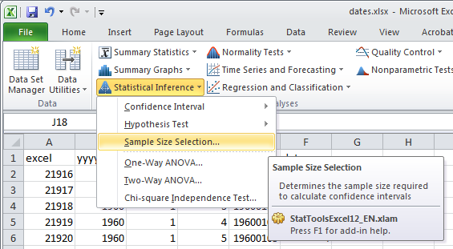
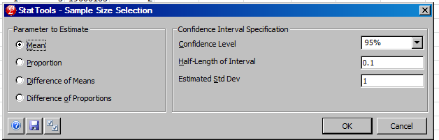
Selecting sample size in Excel
Excel: StatTools → Statistical Inference → Sample Size Selection
Desired m.e.
Sigma or s

